Slide 1
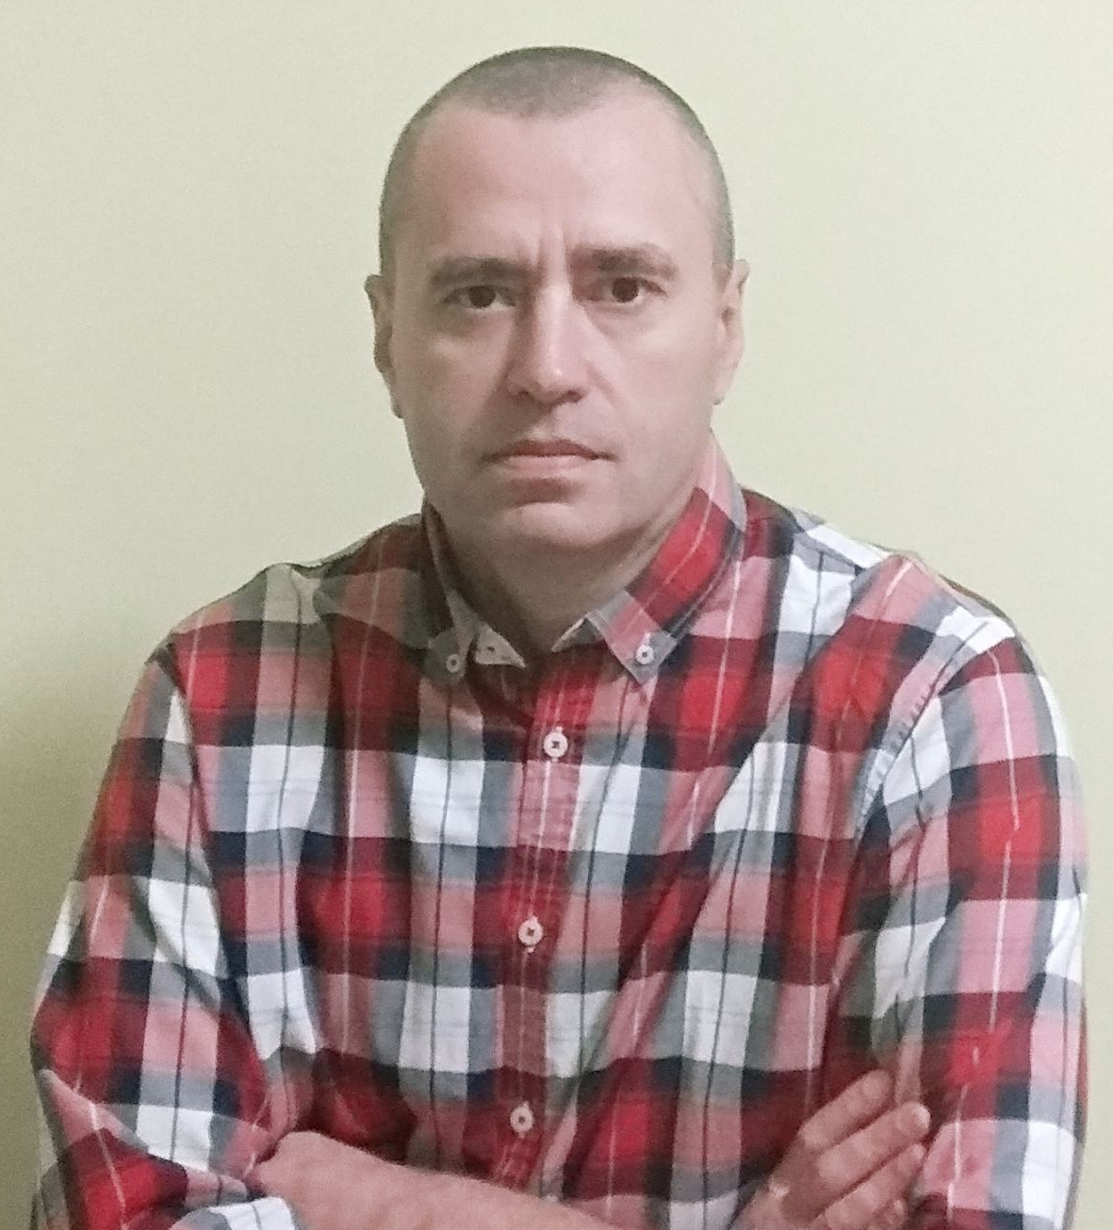
ABOUT ME
Olexandr marchenko
Date of birthday 28/11/75
High education
civil engineer
Exp. In It: beginner (CMS - Wordpress, joomla, zebra)
I want to reach new heights and start working in Epam

Slide 2
Local Infastructure deploy
Local VM with Terraform
Vagrant
Infrastructure deploy
User data Jenkins
SSH key SecGroup
CI/CD
Jenkins build deploy
GitHub
Infrastructure deploy
EC2
Terraform
Push
GitHub Webhook
EC2 instance
Terraform
Infrastructure destroy
Terraform destroy
Step 1
Step 2
Step 3
Step 4
Step 5

Slide 3
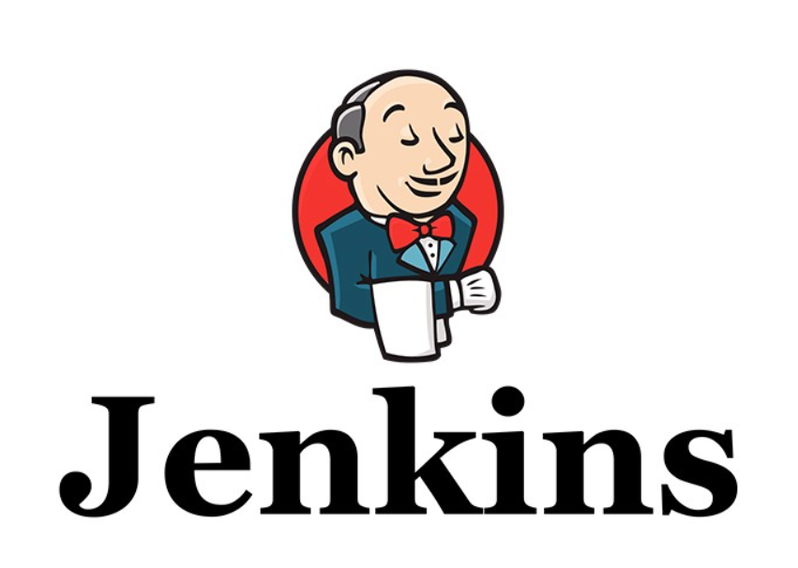


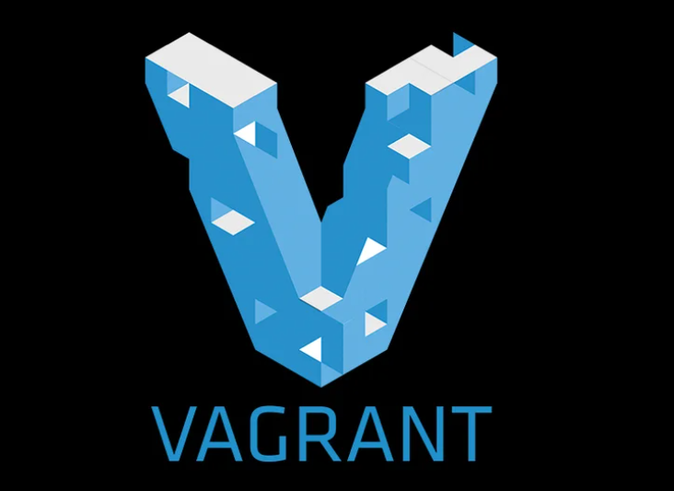
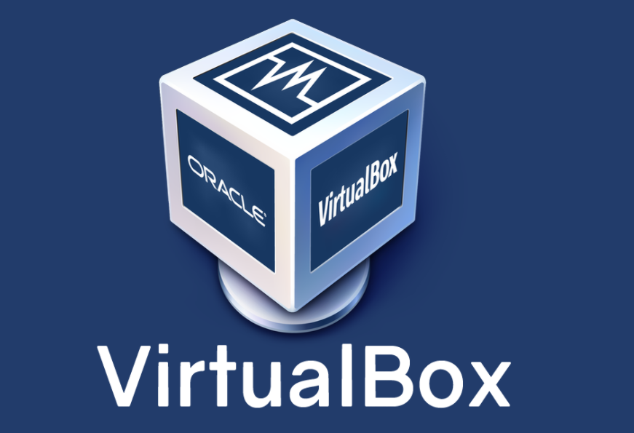
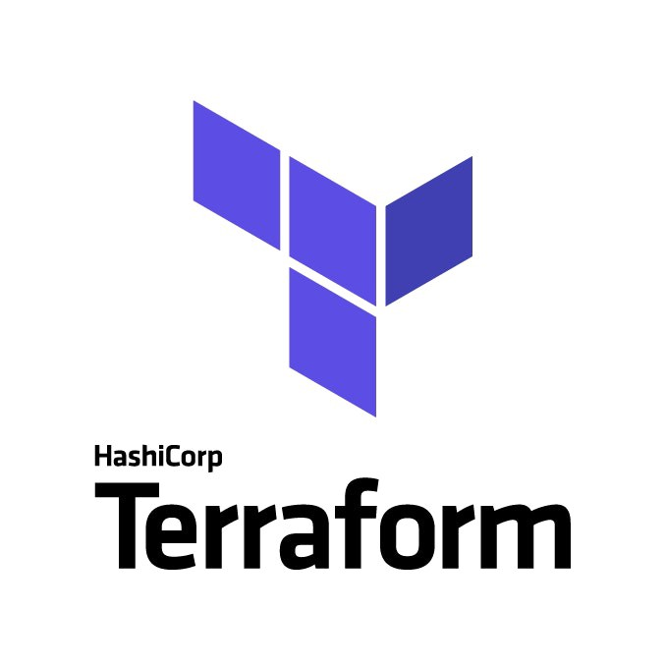
DEPLOY TELEGRAM BOT
For my project I used: Github, Vagrant, Virtualbox, Terraform, Jenkins, AWS
Jenkins login to GitHub (webhook)
Jenkins put on AWS EC2 with notification
Create VM
Develop in VM
Push on GitHub
Vagrant create VM
VM with Terraform
Terraform instance on AWS

Slide 4
REALIZATION
I used Vagarnt for creation VM Ubuntu (my own image) with Terraform (step1) on local host. Then I create instance Ubuntu on AWS with Jenkins (step2).
After that I configurate Jenkins (step3). Used next plugin: CloudBees AWS Credentials, SSH agent, Git plugin, Github plugin, Pipeline etc.
Developer with Windows OS and installed Bush plus credential for GitHub. He edits python scrypt and push on GitHub. Then Github sends webhook for Jenkins (step 3). Jenkins used Jenkinsfile from Github and performs jobs from this file. (take, test, create artefact, create artefact version, deploy , notification.) I created daemon, and a daemon was used to run the application.

Slide 5
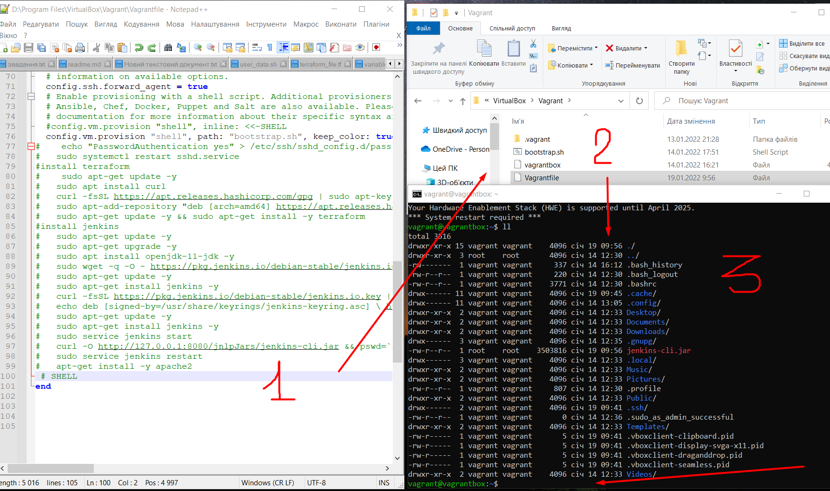
Created vm with vagrant then vagrant up. After then installed terraform.

Slide 6
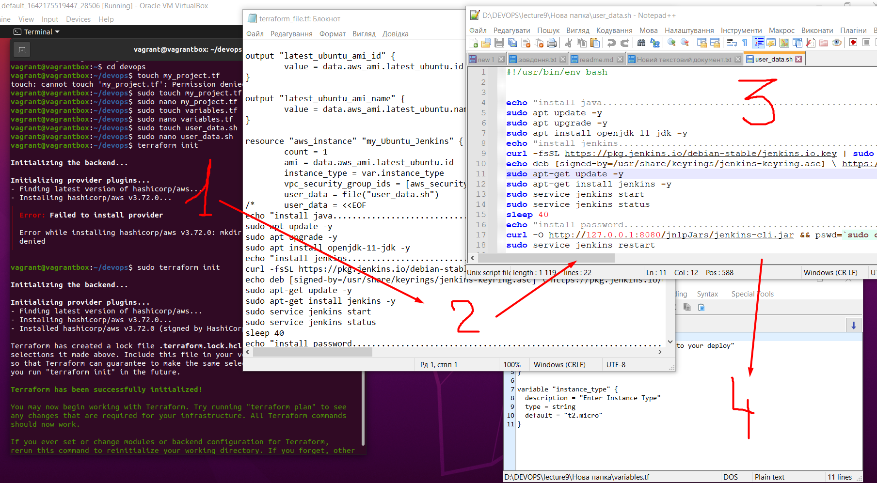
Created (vagrant ssh) project folder and terraform files

Slide 7
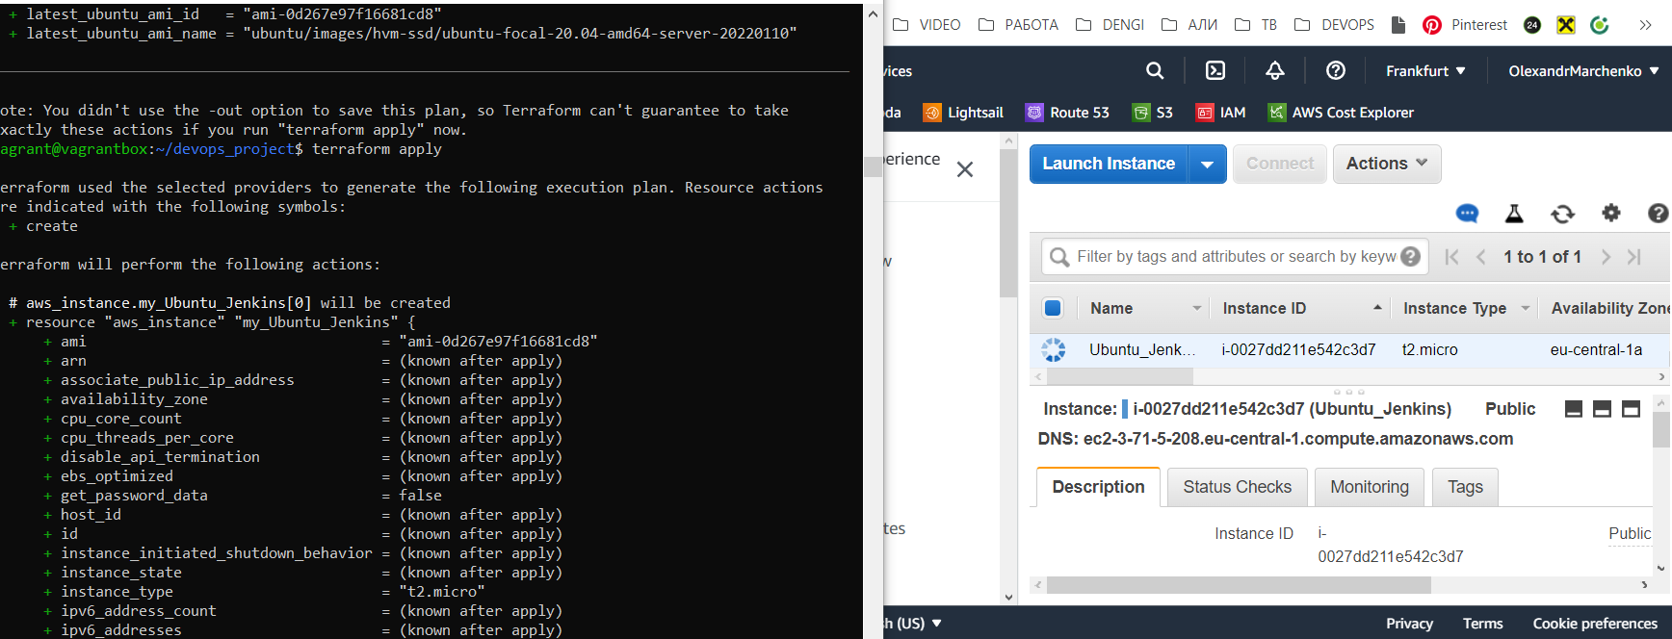
used terraform for create instance on aws. Instance include jenkins

Slide 8
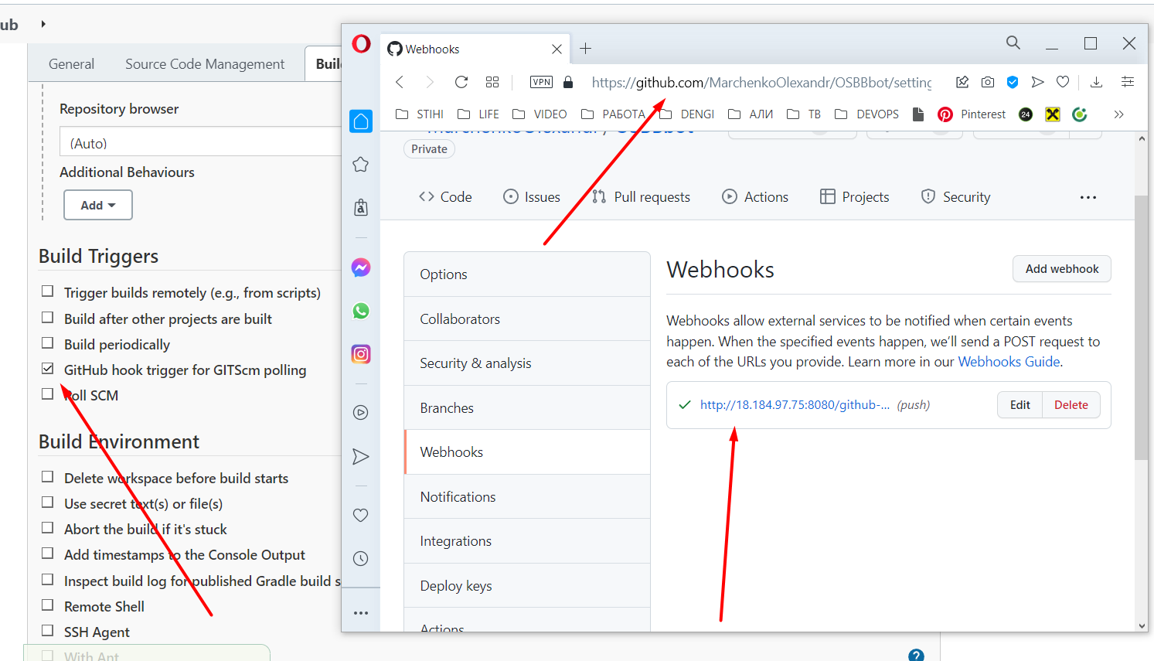
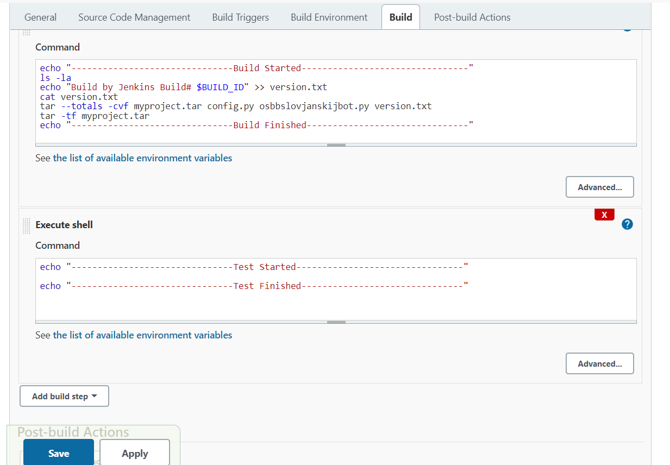
Jenkins pull from github with webhook, save artefact and deploy to server

Slide 9
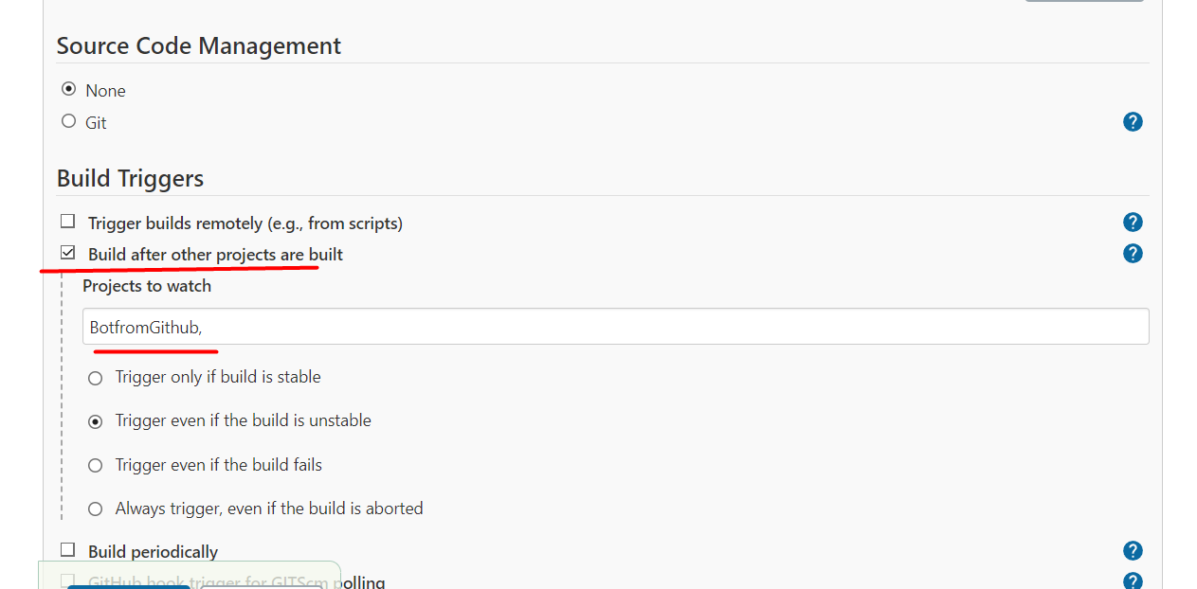
Simple pipeline

Slide 10
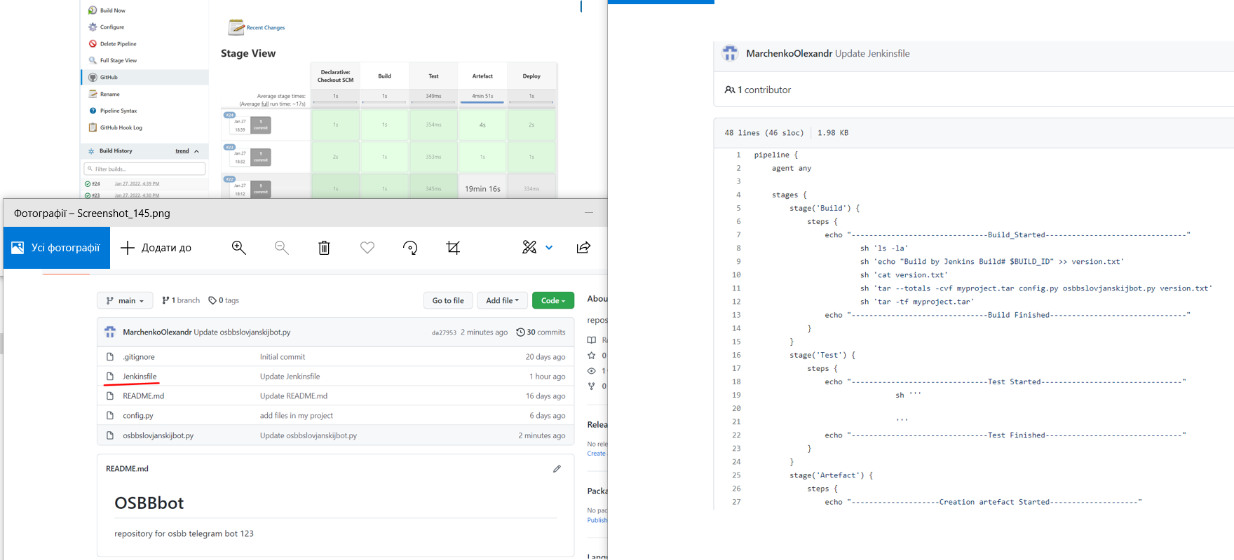
ADD PIPELINE AND JENKINS FILE ON GITHUB. Add notification on telegram chat.

Slide 11
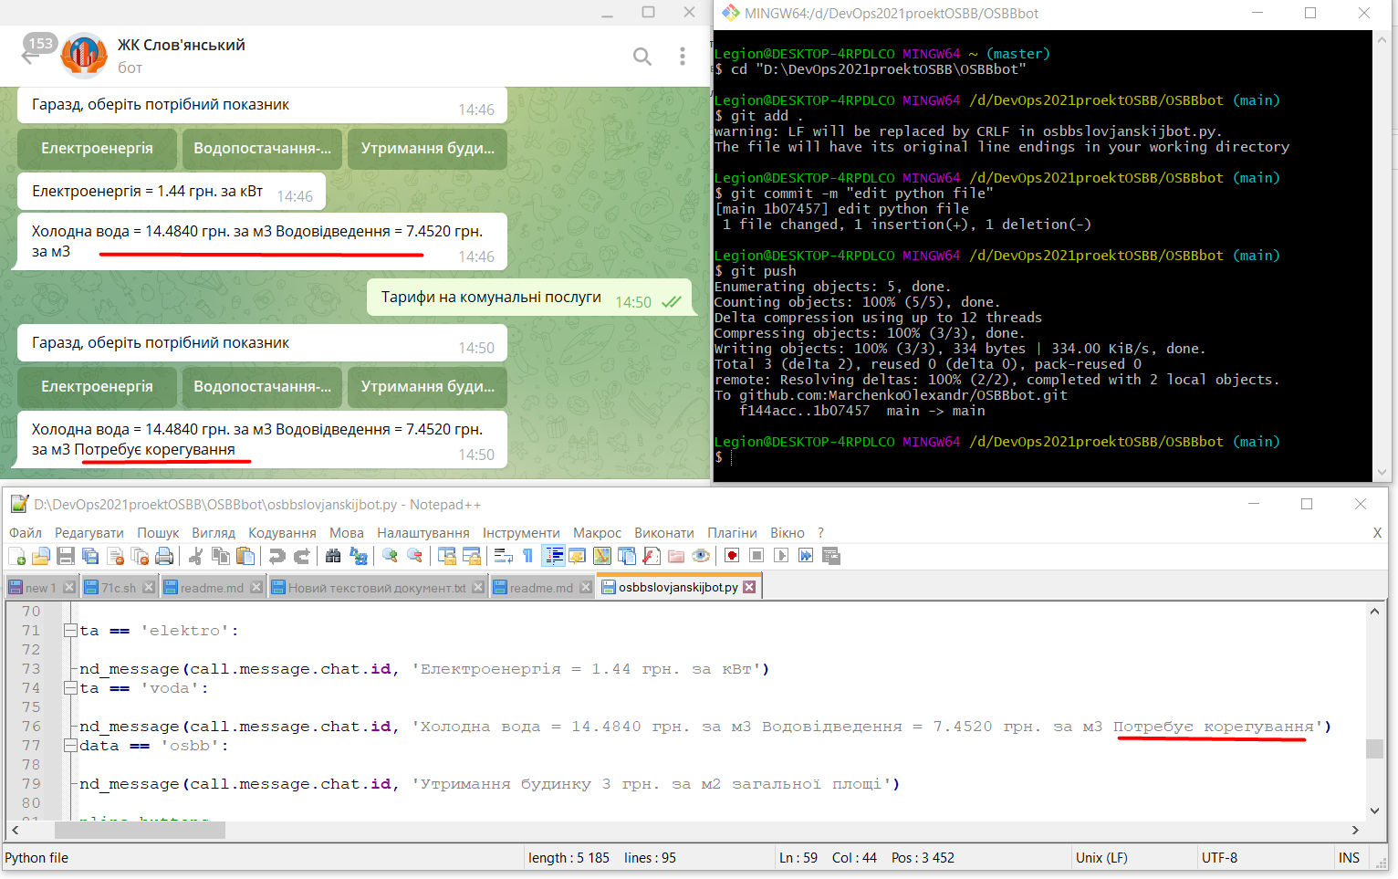
Developer changes python scrypt. Result

Slide 12
WP run with docker-compose
Develop WP-themes
EC2 with Jenkins, Ansible and Terraform
EC2 with Docker-compose + WP phpAdmin +MYSQL
GitHub
Next mini project. I did this project because in course we learned more tools than I used in previous project.
Developer create and then edit wordpress template
He sent this template on Github. Jenkins (from previous project) with webhook take Jenkinsfile and make his jobs: Run terraform. Terraform create new ec2. Run Ansible. Ansible configure ec2. Ansible install and run docker-compose with wordpress.
New tools it’s Ansible and Docker, Docker-compose.

Slide 13
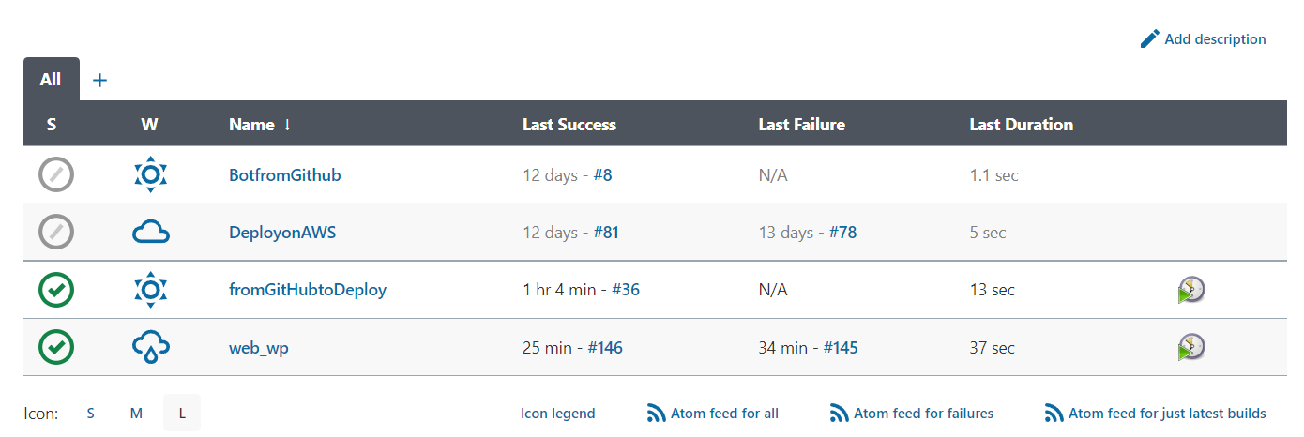
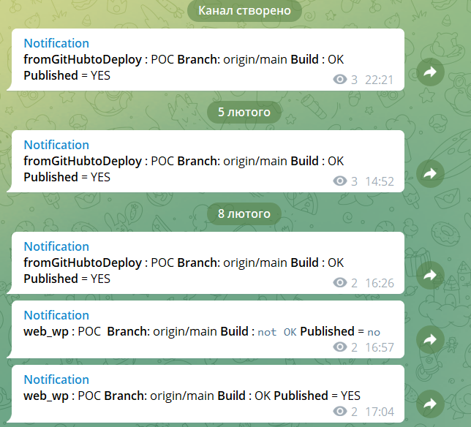
Notification and pipeline with Jenkins file from github. Terraform state on aws s3

